Slide 1
Binary I/O and Serialization

Slide 2
File Storage
Many applications have the need to store some data indefinitely.
Saving information in files is one common approach.
When an application saves information in files, it has as portion of its code devoted to translating to and from the file contents.

Slide 3
Text File Review
At a high level, a file is either categorized as a text file or a binary file.
A text file stores a series of text characters using a character encoding, such as ASCII, UTF-8, or UTF-16.
Text files are generally only useful for character data, and not other kinds of data.

Slide 4
Binary File Review
Any file that is not a text file is a binary file.
The contents and layout of a binary file depend upon its format and the application that supports it.
For all but the application that can decode it, a binary file is generally considered a series of unreadable bytes.
By convention only, an extension (period followed by an acronym) is put in the filename so we know what it is.
Binary files may contain some text, and often consists of specific data structures laid out on disk.

Slide 5
Binary Formats
“Binary” is a very broad category encompassing any file that is not a text file.
Some more specific types are:
png
mp4
zip
pdf
exe
etc…

Slide 6
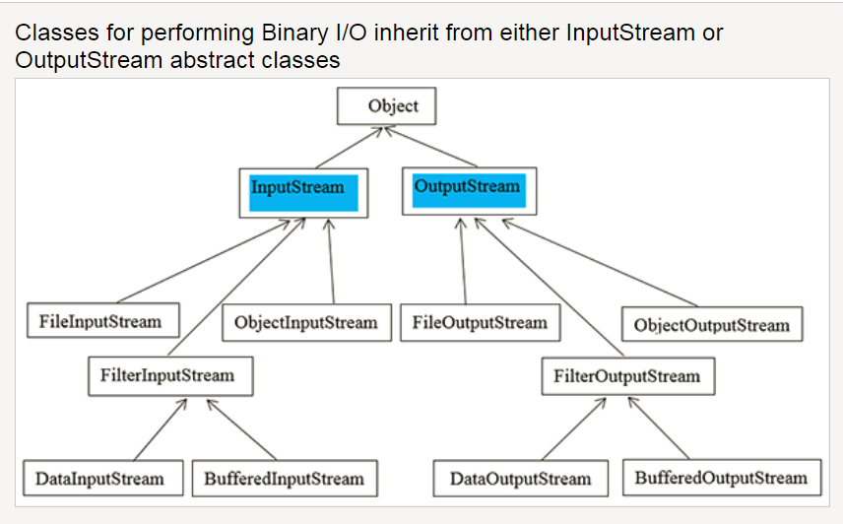
InputStream and OutputStream
Notes:
Taken from http://www.cs.sjsu.edu/faculty/pearce/modules/lectures/oop/streams/streams.htm

Slide 7
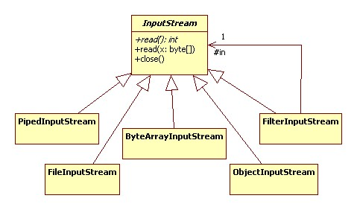
InputStream Details
Notes:
Taken from http://www.cs.sjsu.edu/faculty/pearce/modules/lectures/oop/streams/streams.htm

Slide 8
Basic FileOutput/InputStream Usage
public class BasicInputOutput
{
//Precondition 1: Directory C:\tmp\code exists
//Postcondition 1: 255, 0, 1, ..., 9 have been written to and read from file C:\tmp\code\first.dat
//Postcondition 2: 255, 0, 1, ..., 9 are on the console
public static void main(String[] args) {
try (FileOutputStream outfile = new FileOutputStream("C:\\tmp\\code\\first.dat")) {
outfile.write(255);
for (int i = 0; i < 10; i++)
outfile.write(i);
}
catch (IOException ex) {
ex.printStackTrace();
}
try (FileInputStream infile = new FileInputStream("C:\\tmp\\code\\first.dat")) {
int smallvalue = infile.read();
System.out.println(smallvalue);
while ((smallvalue = infile.read()) != -1)
System.out.println(smallvalue);
}
catch (IOException ex) {
ex.printStackTrace();
}
}
}
Output
255
0
1
2
...

Slide 9
DataInput/OutputStream
public class DataStreamDemo
{
public static void main(String[] args) throws IOException {
try (DataOutputStream outfile = new DataOutputStream(new FileOutputStream("C:\\tmp\\code\\second.dat"))) {
outfile.writeUTF("John Galswarthy");
outfile.writeInt(1906);
outfile.writeUTF("Frederick Marryat");
outfile.writeDouble(1847.1);
outfile.writeUTF("Walter Scott");
outfile.writeDouble(1820.3);
outfile.writeUTF("\u005f"); //underscore
}
try (DataInputStream infile = new DataInputStream(new FileInputStream("C:\\tmp\\code\\second.dat"))) {
System.out.printf("%-20s %d%n", infile.readUTF(), infile.readInt());
System.out.printf("%-20s %f%n", infile.readUTF(), infile.readDouble());
System.out.printf("%-20s %f%n", infile.readUTF(), infile.readDouble());
System.out.printf(infile.readUTF());
}
}
}
Output
John Galswarthy 1906
Frederick Marryat 1847.100000
Walter Scott 1820.300000
_
Notes:
DataInputStream reads bytes from the stream and delivers them as corresponding primitive types or Strings.
DataOutputStream converts primitive-type values or Strings into bytes and writes the bytes to the stream.
Good for working with specific datatypes instead of reading everything in a bytes and doing manual conversions.

Slide 10
Java Serialization
Object serialization encodes an into a sequence of bytes.
Serialization includes the object's data, information about the object's type, and information about the types of data stored in the object.
Object deserialization decodes the sequence of bytes back into a Java object.
The process is platform independent; objects serialized on one platform can be deserialized on another platform.
The process is version dependent; an encoding from one Java version may or may not be compatible with another version.

Slide 11
Serializable Interface
For its objects to be serialized, a class must meet two requirements:
it implements the Serializable interface.
all of its members are serializable (are either primitive types or implement the Serializable interface), or are marked transient.
public class Employee implements Serializable {
private int id;
private String name;
private double salary;
public Employee(int anId, String aName, double aSalary) {
id = anId;
name = aName;
salary = aSalary;
}
public String toString() {
return "id = " + id + " name = " + name + " salary = " + salary;
}
}

Slide 12
ObjectInput/Output Stream
public class SerializationDemo {
public static void main(String[] args) {
try {
try (ObjectOutputStream outfile = new ObjectOutputStream(new FileOutputStream("C:\\tmp\\code\\objectfile.dat"))) {
outfile.writeObject(new Employee(1, "Keats", 400.50));
outfile.writeObject(new Employee(2, "Shelly", 200.75));
outfile.writeObject(new Employee(3, "Byron", 500.00));
}
try (ObjectInputStream infile = new ObjectInputStream(new FileInputStream("C:\\tmp\\code\\objectfile.dat"))) {
for (int i = 0; i < 3; i++) {
System.out.printf("%s%n", (Employee) (infile.readObject()));
}
}
}
catch (IOException | ClassNotFoundException ex) {
ex.printStackTrace();
}
}
}
Output
id = 1 name = Keats salary = 400.5
id = 2 name = Shelly salary = 200.75
id = 3 name = Byron salary = 500.0
Notes:
Classes ObjectInputStream and ObjectOutputStream are high-level streams that contain the methods for serializing and deserializing an object.

Slide 13
Tips on Serialization
Serialization is useful for scenarios where you need to effortlessly encode and decode an object while an application is running.
Serialization is surprisingly dangerous if the object is stored and retrieved long-term.
There is no guarantee any future version of Java will read the object.
There is no guarantee your application will have the exact same version of the object.
Serializing to XML instead of binary alleviates some but not all of these problems.
Notes:
JAXB is an alternative to Serialization which writes Java Objects to XML. You just have to be careful when updating your objects because that could easily break your Marshall and unMarshall (Serializing and DeSerializing) – There are other libraries that are acceptable too – Serializing to JSON
GOAL FOR ASSIGNMENT: OBJECT READING AND WRITING – JSON, XML, BINARY all of these formats are acceptable this week

Slide 14

End

